Slide 1
NECROTIZING PNEUMONIA
IN CHILDREN
Dr Truong Thi Thanh Thao
Notes:
Necrotizing pneumonia (NP), sometimes called cavitary pneumonia, cavitary necrosis or pulmonary gangrene,

Slide 2
CONTENTS
Definition
Pathogens
Treatment
Conclusions

Slide 3
DEFINITION
Necrotizing pnemonia is defined as necrosis of the pulmonary tissue and formation of lolitary or multiple small cavities(<2 cm) containing necrotic debris or fluid.

Slide 4
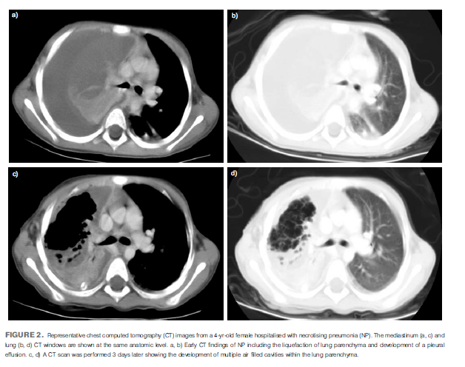
Notes:
Representative chest computed tomography (CT) images from a 4-yr-old female hospitalised with necrotising pneumonia (NP). The mediastinum (a, c) and
lung (b, d) CT windows are shown at the same anatomic level. a, b) Early CT findings of NP including the liquefaction of lung parenchyma and development of a pleural
effusion. c, d) A CT scan was performed 3 days later showing the development of multiple air filled cavities within the lung parenchyma

Slide 5
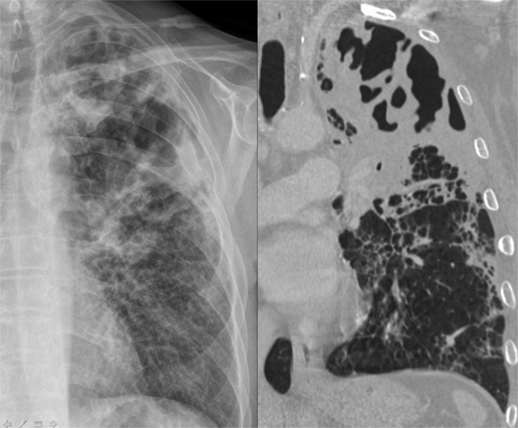

Slide 6
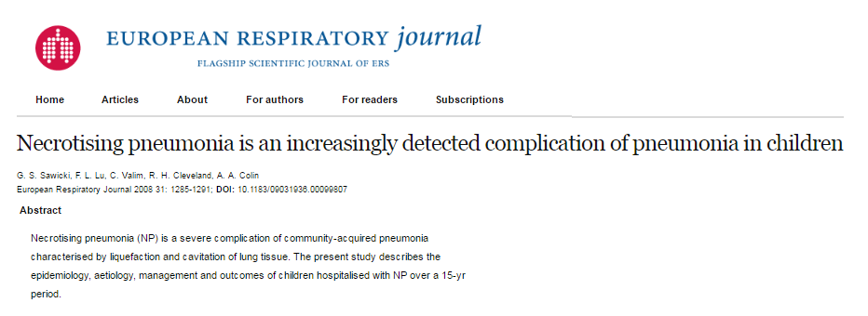

Slide 7
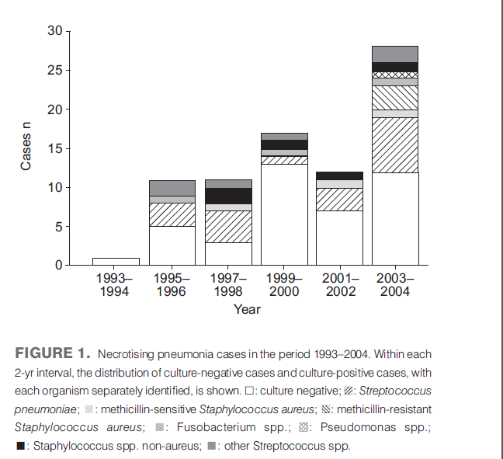
(G.S. Sawicki,+, F.L. Lu,+, C. Valim, R.H. Cleveland" and A.A. Colin. Necrotising pneumonia is an increasingly detected complication of pneumonia in children. Eur Journals Ltd 2008)

Slide 8
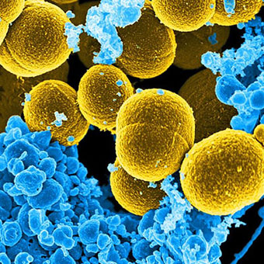
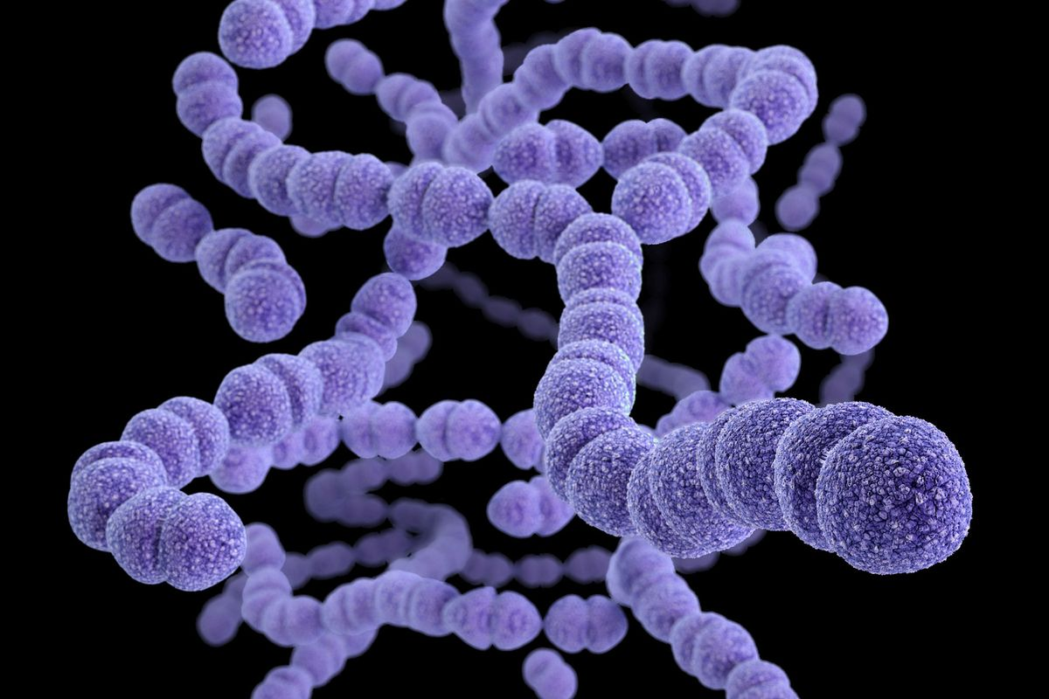
PATHOGEN
Notes:
Children’s Hospital Boston, 300 Longwood Avenue, Boston, USA

Slide 9
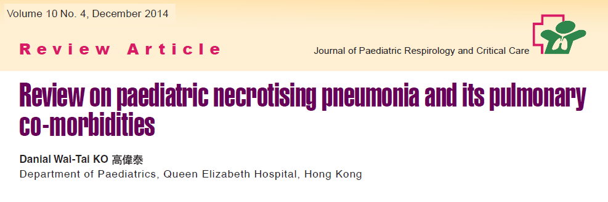
Notes:
1994-2013
261 cases

Slide 10
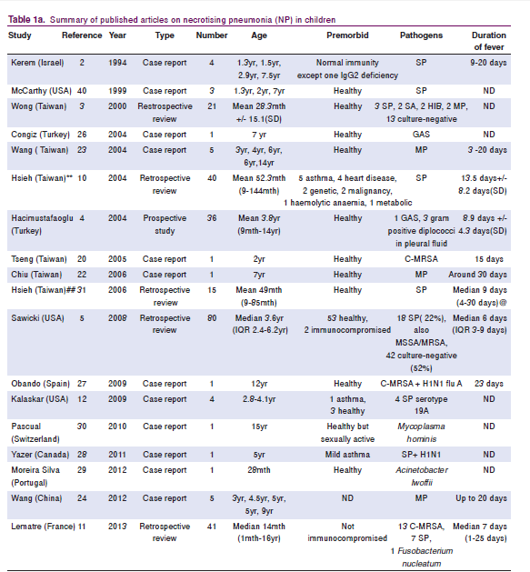

Slide 11
Staphylococcus Aureus and Streptococcus Pneumoniae are the main agents.

Slide 12
TREATMENT
A prolonged course of IV antibiotics is the cornerstone.
The initial choice of antibiotics base on local epidemiologic and microbiological results.

Slide 13
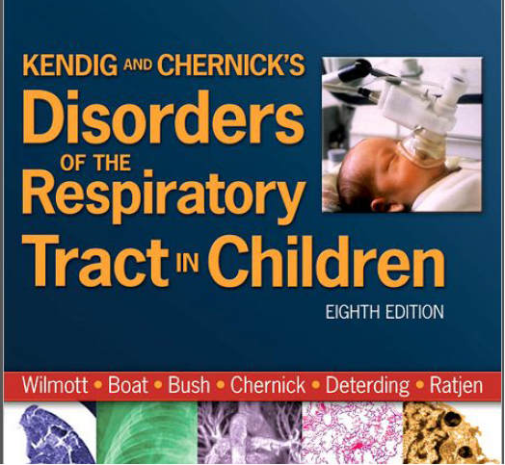
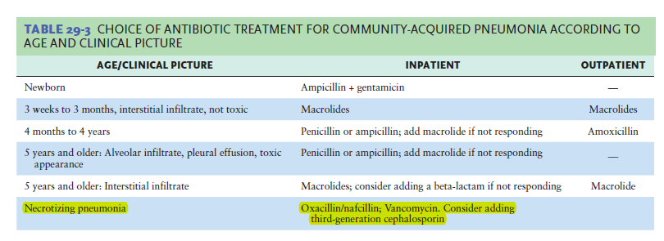

Slide 14
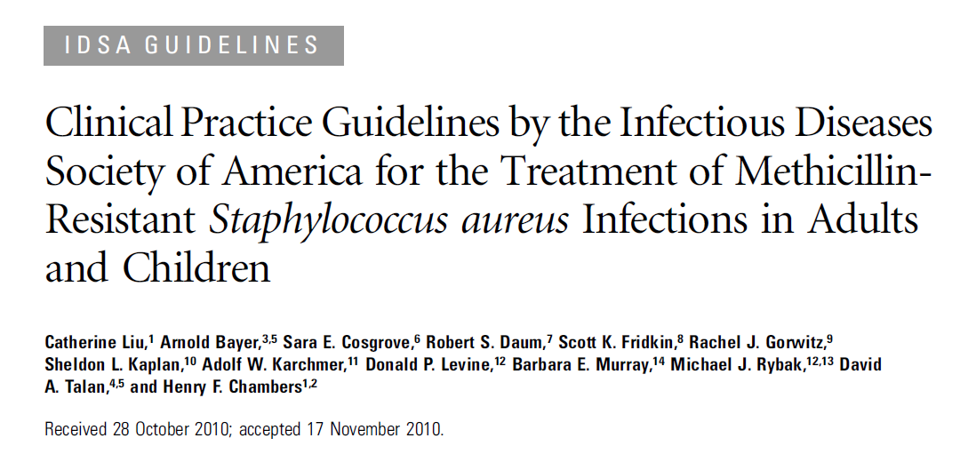

Slide 15
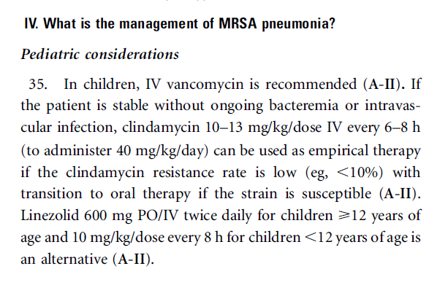

Slide 16
Staphylococcus Aureus
Panton Valentine Leukocidin (+)
Anaerobic

Slide 17
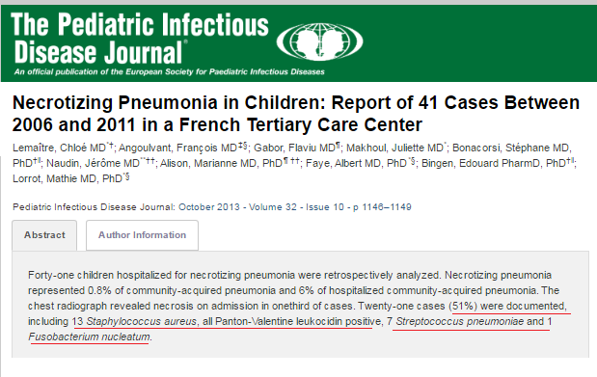
→ 51% were documented
Staphylococcus Aureus ( 61,9%)
(all Panton Valentine Leukocidin positive)
Streptococcus Pneumoniae ( 33,3%)
Anaerobic (4,8%)

Slide 18
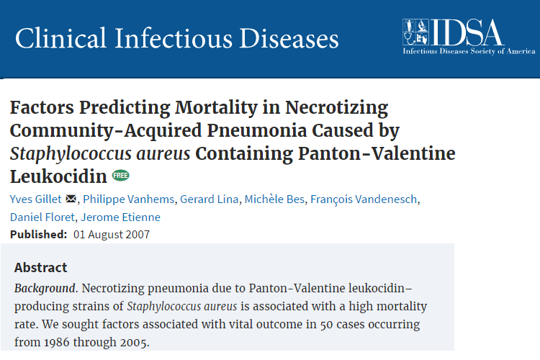


Slide 19
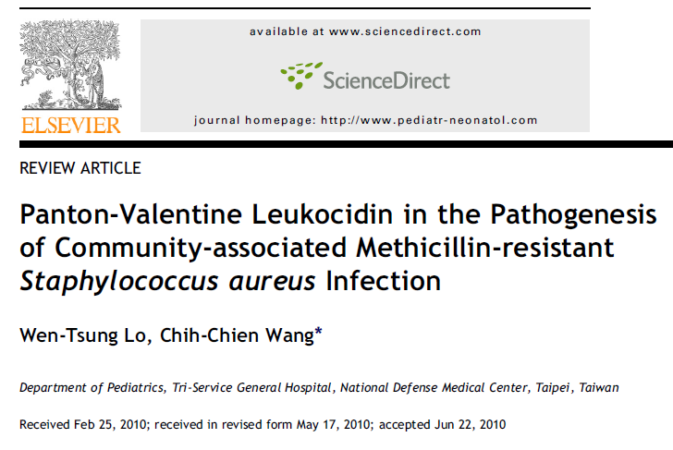

Slide 20

April to June 2017
Total :281 cases
Staphylococcus Aureus MRSA (+) : 83%

Slide 21
➔ Clindamycine, Rifampicine, Linézolide, acid fusidic : inhibit PVL (+) S. Aureus
Panton-Valentine Leukocidin in the Pathogenesis of Community-associated Methicillin-resistant Staphylococcus aureus infection;Wen-Tsung Lo, Chih-Chien Wang Department of Pediatrics, Tri-Service General Hospital, National Defense Medical Center, Taipei, Taiwan. Received May 17, 2010; Elsevier Jun 22, 2010

Slide 22
Initial treatnent like complicated CAP
Ceftriaxone 100 mg/kg IV in two divided doses up to a maximum dose of 4 g/day, OR Cefotaxime 150 mg/kg per day IV in four divided doses up to a maximum of 10 g/day, PLUS Clindamycin 30 to 40 mg/kg per day IV in three or four divided doses to a maximum of 1 to 2 g/day if S. aureus or anaerobes are a consideration.
Vancomycin 40 to 60 mg/kg per day IV in three or four divided doses up to a maximum of 4 g/day is an alternative to Clindamycin if the patient is allergic to clindamycin or if clindamycin-resistant S. aureus is prevalent in the community. [uptodate2017]

Slide 23
The duration is determined by the clinical response but is usually a total of four weeks or two weeks after the patient is afebrile and has improved clinically.
    [uptodate2017]

Slide 24
Role of surgery on NP
Surgical intervention for NP should be avoided
as NP usually has an excellent outcome in children.
(B-II). (American Pediatric Surgical Association)

Slide 25
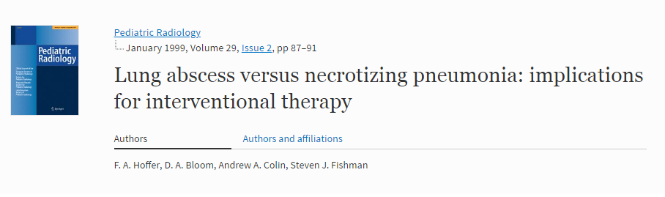

Slide 26
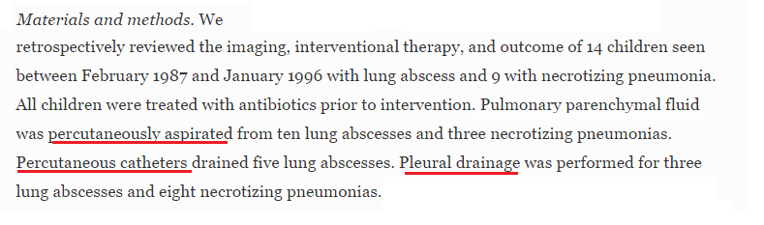

Slide 27
The suggestion is based on the evidence that drainage of necrotic lung tissue actually led to the development of bronchopleural fistula.

Slide 28
COMLICATIONS
SEPSIS , SEPTIC shock
Pleural effusion/Empyema
Pneumothorax
Bronchopleural fistula
Pneumatocele

Slide 29
OUTCOME

Slide 30
Long-term clinical outcomes are excellent.
Pulmonary function testing had essentially normal result.
Chest radiographs and CT scans have shown almost complete normalisation of pulmonary parenchyma.
  (G.S. Sawicki,+, F.L. Lu,+, C. Valim, R.H. Cleveland" and A.A. Colin. Necrotising pneumonia is an increasingly J, Bonacorsi S, Naudin J, et al. Necrotizing pneumonia in children. Redetected complication of pneumonia in children. Eur Journals Ltd 2008)

Slide 31
Mortality: 6/261 (2,3%)
(Danial Wai-Tai KO, Review on paediatric necrotising pneumonia and its pulmonary co-morbidities, Journal of Paediatric Respirology and Critical Care, December 2014)

Slide 32
CONCLUSION
Necrotizing pneumonia is the complication of pneumonia in children.
Pathogens: Staphylococcus Aureus (MRSA-PVL(+))
Streptococcus Pneumoniae
Anaerobic
Antibiotic is the main therapy (Clindamycin)
Duration of treatment : 4 weeks or 2 weeks after the patient is afebrile and has improved clinically.
Surgical intervention for NP should be avoided.

Slide 33
Reference
Uptodate 2017
Liu, C., et al., Clinical practice guidelines by the infectious diseases society of america for the treatment of methicillin-resistant Staphylococcus aureus infections in adults and children. Clin Infect Dis, 2010
G.S. Sawicki,+, F.L. Lu,+, C. Valim, R.H. Cleveland" and A.A. Colin. Necrotising pneumonia is an increasingly J, Bonacorsi S, Naudin J, et al. Necrotizing pneumonia in children. Redetected complication of pneumonia in children. Eur Journals Ltd 2008
Lemaitre C, Angoulvant F, Gabor F, Makhoul port of 41 cases between 2006 and 2011 in a French tertiary care center. Pediatr Infect Dis J. 2013.
Tsai Y-F, Ku Y-H. Necrotizing pneumonia: a rare complication of pneumonia requiring special consideration. Curr Opin Pulm Med. 2012
L. López González, I. Herráez Ortega, L. González Pastrana, E.Zorita Argüero, C. Cordero Lares, R. Management of necrotizing pneumonia in children. ECR 2012
Kyung Mi Park,¹ Seung Kook Son,¹ Hye-Young Kim,¹ Yong-Woo Kim,² Jae-Yeon Hwang. and Hee Ju Park. Clinical features of necrotizing pneumonia in children. Allergy Asthma Respir Dis. 2014 Jul.
F. A. Hoffer, D. A. Bloom, Andrew A. Colin, Steven J. Fishman. Lung abscess versus necrotizing pneumonia: implications for interventional therapy, January 1999
Danial Wai-Tai KO, Review on paediatric necrotising pneumonia and its pulmonary co-morbidities
Bradley JS, Byington CL, Shah SS, Alverson B, Carter ER, et al. Pediatric Infectious Diseases Society and the Infectious Diseases Society of America. The management of community-acquired pneumonia in infants and children older than 3 months of age: clinical practice guidelines by the Pediatric Infectious Diseases Society and the Infectious Diseases Society of America. Clin Infect Dis 2011
Notes:
lung gangrene
necrotizing pneumonia

Slide 34


